Slide 1
A guide to developing applications with Hyperledger and Blockchain
Lennart Frantzell, IBM Developer Advocate, San Francisco 2018/11/1
Notes:
Blockchain essentially a database, but traditional databases have central admins, which makes using them to house transaction data involving parties that don’t trust one another problematic and expensive. So, each entity maintains their own database, resulting in duplicate data and, if there are mistakes or malicious behavior, results in expensive and time consuming disputes over what the actual state of the truth is. This is particularly true when exchanging assets. And lots of different institutions recording different assets.

Slide 2
The Basics

Slide 3
Introduction to Blockchain
October 2008, it all started with Satoshi Nakamoto and his historic paper Bitcoin, a Peer-to-Peer Electronic Cash System https://bitcoin.org/bitcoin.pdf.Which addressed a key problem:
A purely peer-to-peer version of electronic cash would allow online payments to be sent directly from one party to another without going through a financial institution. Digital signatures provide part of the solution, but the main benefits are lost if a trusted third party is still required to prevent double-spending. We propose a solution to the double-spending problem using a peer-to-peer network.

Slide 4
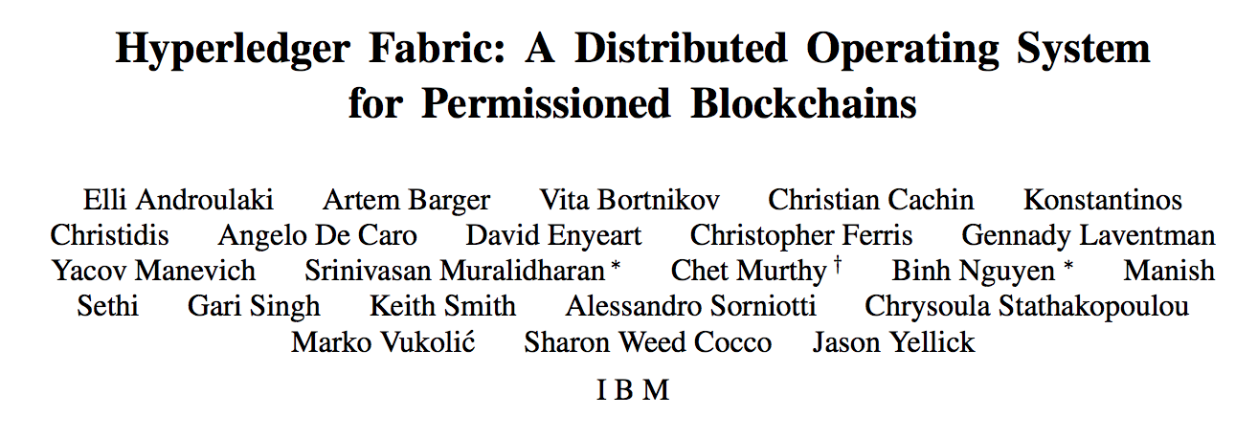
https://arxiv.org/pdf/1801.10228v1.pdf

Slide 5
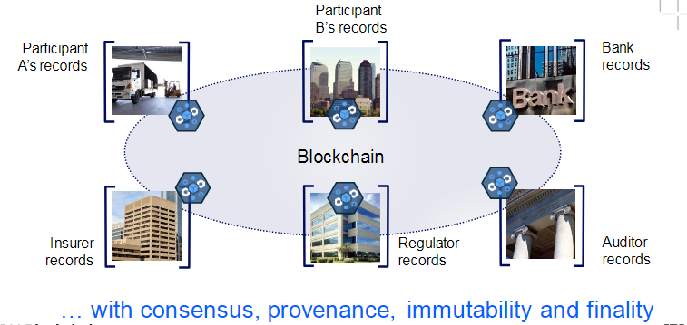
A shared, replicated, permissioned ledger
No central, third-party mediator,
such as a financial institution
or clearinghouse, is involved
No reconciliation needed

Slide 6
Blockchain

Slide 7

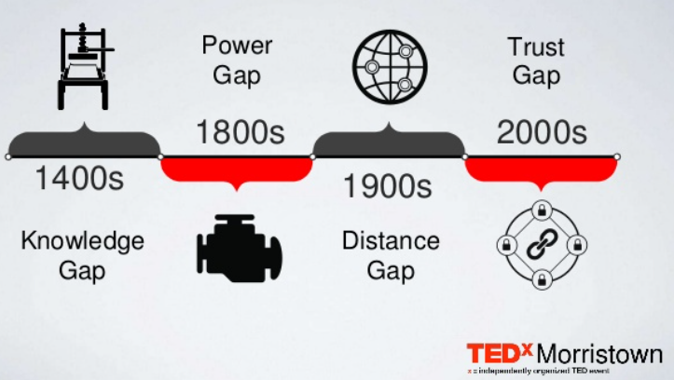

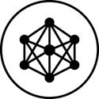
Blockchain global impact
10% of Global GDP
$176 Billion
will be stored on blockchains or blockchain related technology by 2025. ¹
The business value added by blockchain by 2025, then surge to exceed $3.1 trillion by 2030. 2
17% of Banks
$2.3 Billion
Released a Blockchain application in 2017. 3
Estimated size of the Blockchain technology market by 2021. 4
¹ Source: World Economic Forum
³ Source: IBM
² Source: Gartner
⁴ Source: MarketandMarkets

Slide 8



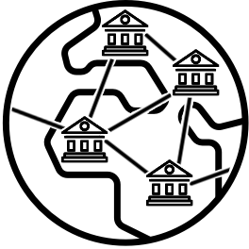

Re-imagining digital business processes
World Wire
Connects the ecosystem: brings together ports, terminals, ocean carriers, government authorities, etc
Drives true information sharing: real-time and seamless actionable insight
Fosters collaboration and trust: automate cross-org business processes
Shared visibility and shared state for shipments
Manage quality risk: enable rapid, low cost, food recalls
End to End transparency: data sharing extends beyond 'one up, one down’!
Trust and Audit: ensure provenance with easily trusted, auditable records.
Consumer confidence: comprehensively communicate with end consumer
24x7 payments: payment support regardless of size, origination, destination or asset type
Higher visibility: for streamlined transactions with reduced disputes and reconciliation needs
Regulatory compliance: enhanced through improved transparency
Secure network: with interaction and eligibility criteria & robust access control
Trade finance platform: backed by a consortium of major international banks
Full function: enables accurate trading posture information, order to settlement control, risk coverage, track and trace options
Near-real time: exchange of information
Discovery: Allows buyers to discover trusted sellers and vice-versa
Notes:
We’re seeing lots of networks forming

Slide 9



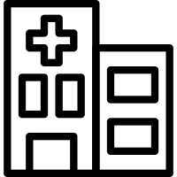

Self-sovereign Identity example
You’re now a Doctor
Verifiable credential
I’m a Doctor
Yes, you’re a Doctor
Issues
Credential
Presents
Credential
University
Issues
Doctor
Acquires, Stores, Presents
Hospital
Requests, Verifies
Verifiable credential
Verifiable credential
Signs
Credential
Countersigns
Credential
Verifies
Signatures
Decentralized Identifiers (DIDs)
Blockchain
Notes:
With multiple networks, self sovereign identity becomes important, otherwise it becomes difficult to manage policy based systems.
Key concepts:
Decentralised identifiers (DIDs):
Universal, standardized identifier for verifiable, self sovereign identity
Fully under the control of person, institution, or thing. User owned and governed
URL maps an identity for a trusted interaction to a subject
Verifiable Credentials (VCs):
Cryptographically backed statements of truth
Standard mechanism for defining, exchanging and verifying digital information
Ecosystem of issuers, verifiers and owners
Distributed Key Management System (DKMS)
User permissioning
Users own their keys and have a public key ring for those they interact with
Public key rings are used to resolve and verify interactions using DIDs

Slide 10




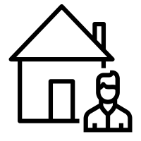












Bank
Towards a Network of Networks
Port Authority
Manufacturer
Correspondent Bank
Shipper
Importer
Insurance
Global trade
Trade finance
Air transport
Manufacturer
Insurance
Regulator
Merchant Bank
Regulator
Brokers
Distribution
Producer
Underwriters
Retail
Agricultural
Syndicates
Manufacturer
Consumers

Slide 11
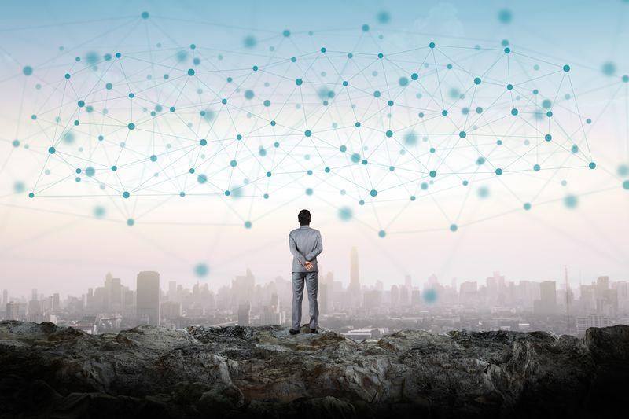
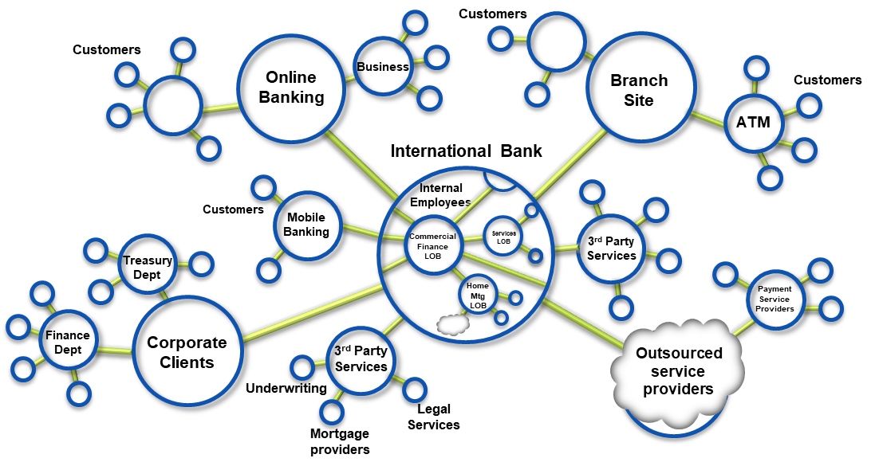
Blockchain builds on basic business concepts
Business Networks connect businesses
Participants with Identity
Assets flow over business networks
Transactions describe asset exchange
Contracts underpin transactions
The ledger is a log of transactions
Blockchain provides an immutable, shared, replicated ledger
Notes:
Blockchain gives us a shared, replicated, permissioned, ledger

Slide 12
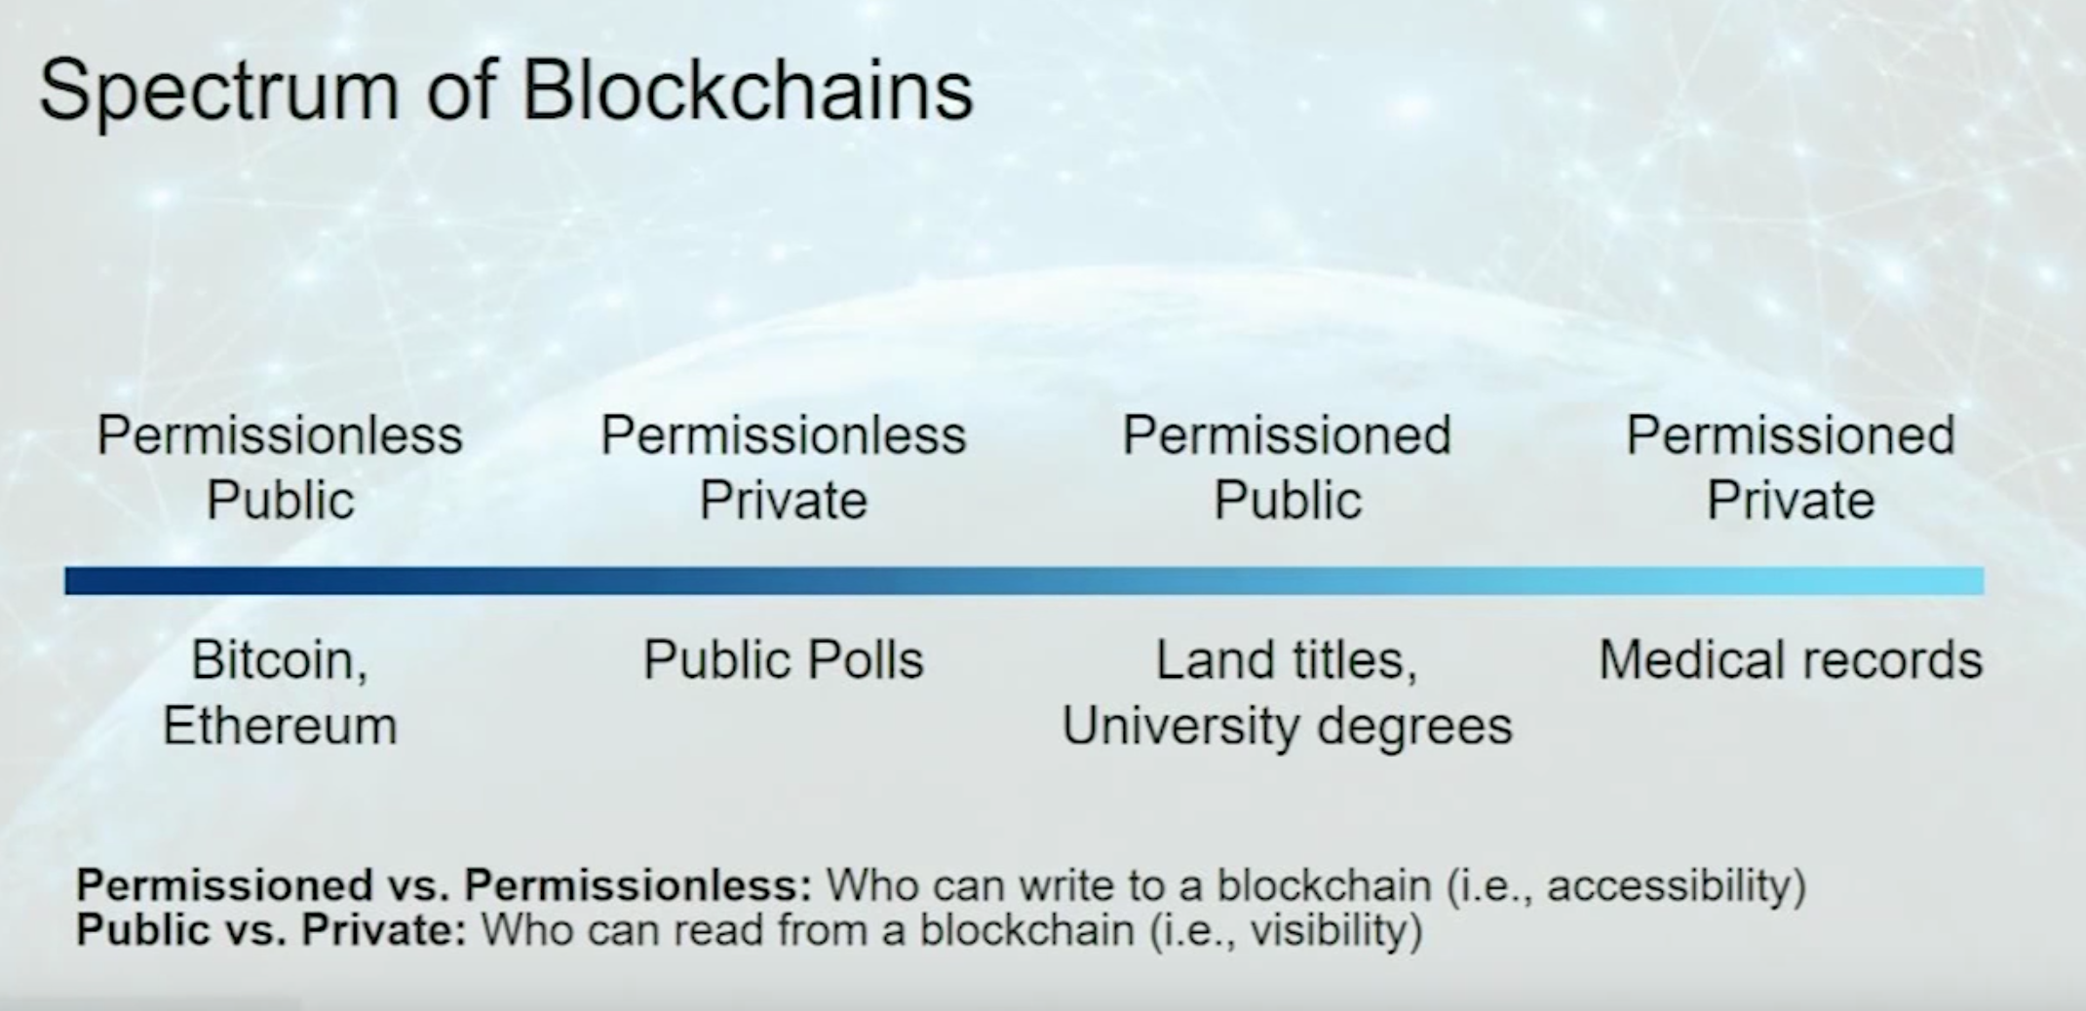
https://www.youtube.com/watch?v=-O3ouBdG3Xg

Slide 13
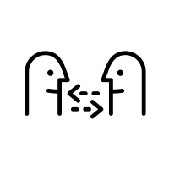
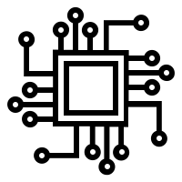
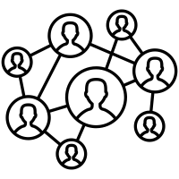
Blockchain in 2018
Technologies
Topics
Communities
Bitcoin
Ethereum
Hyperledger
CORDA
Ripple
BigChainDB
Quorum
Stellar
+++
Shared Ledger & smart contracts
Public, private
Permissioned, permission-less
Tokens and incentive mechanisms
Identity and Zero Knowledge
Consensus mechanisms
On-chain, off-chain
Systems integration
Inter-ledgering
Physical-digital with IOT
Bitcoin
Ethereum
Linux Foundation / Hyperledger
EEA
ISO/TC 307 – Blockchain & DLT
IEEE Blockchain
W3C Blockchain Community
Accord Project
Sovrin
DIF

Slide 14
Hyperledger

Slide 15
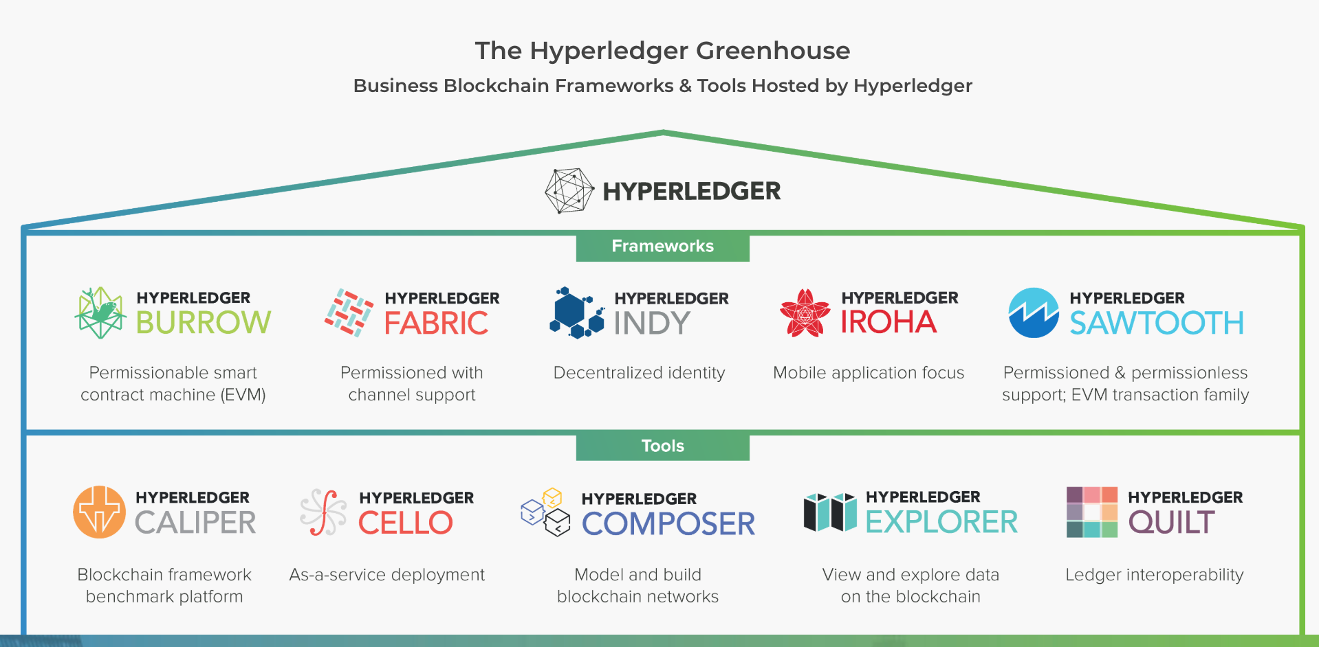

Slide 16
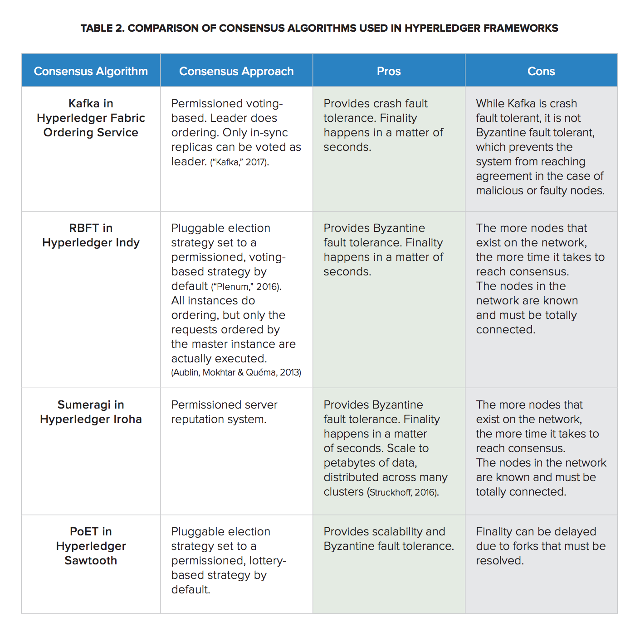
https://www.hyperledger.org/wp-content/uploads/2017/08/Hyperledger_Arch_WG_Paper_1_Consensus.pdf

Slide 17
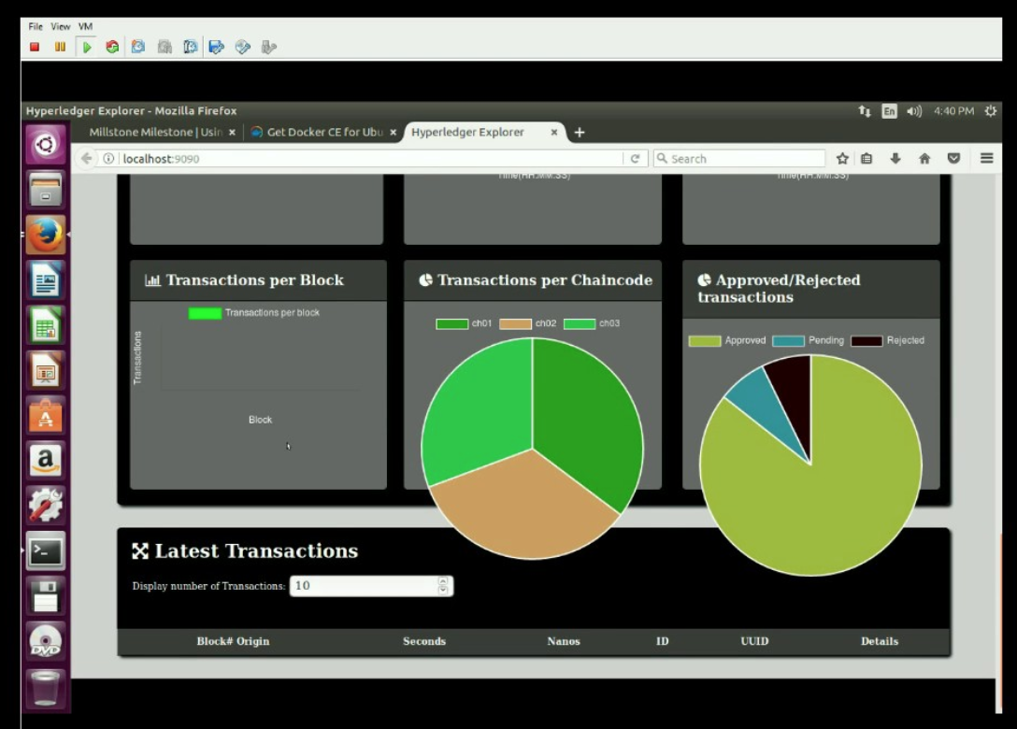
Hyperledger Explorer console
at 08.32.05

Slide 18
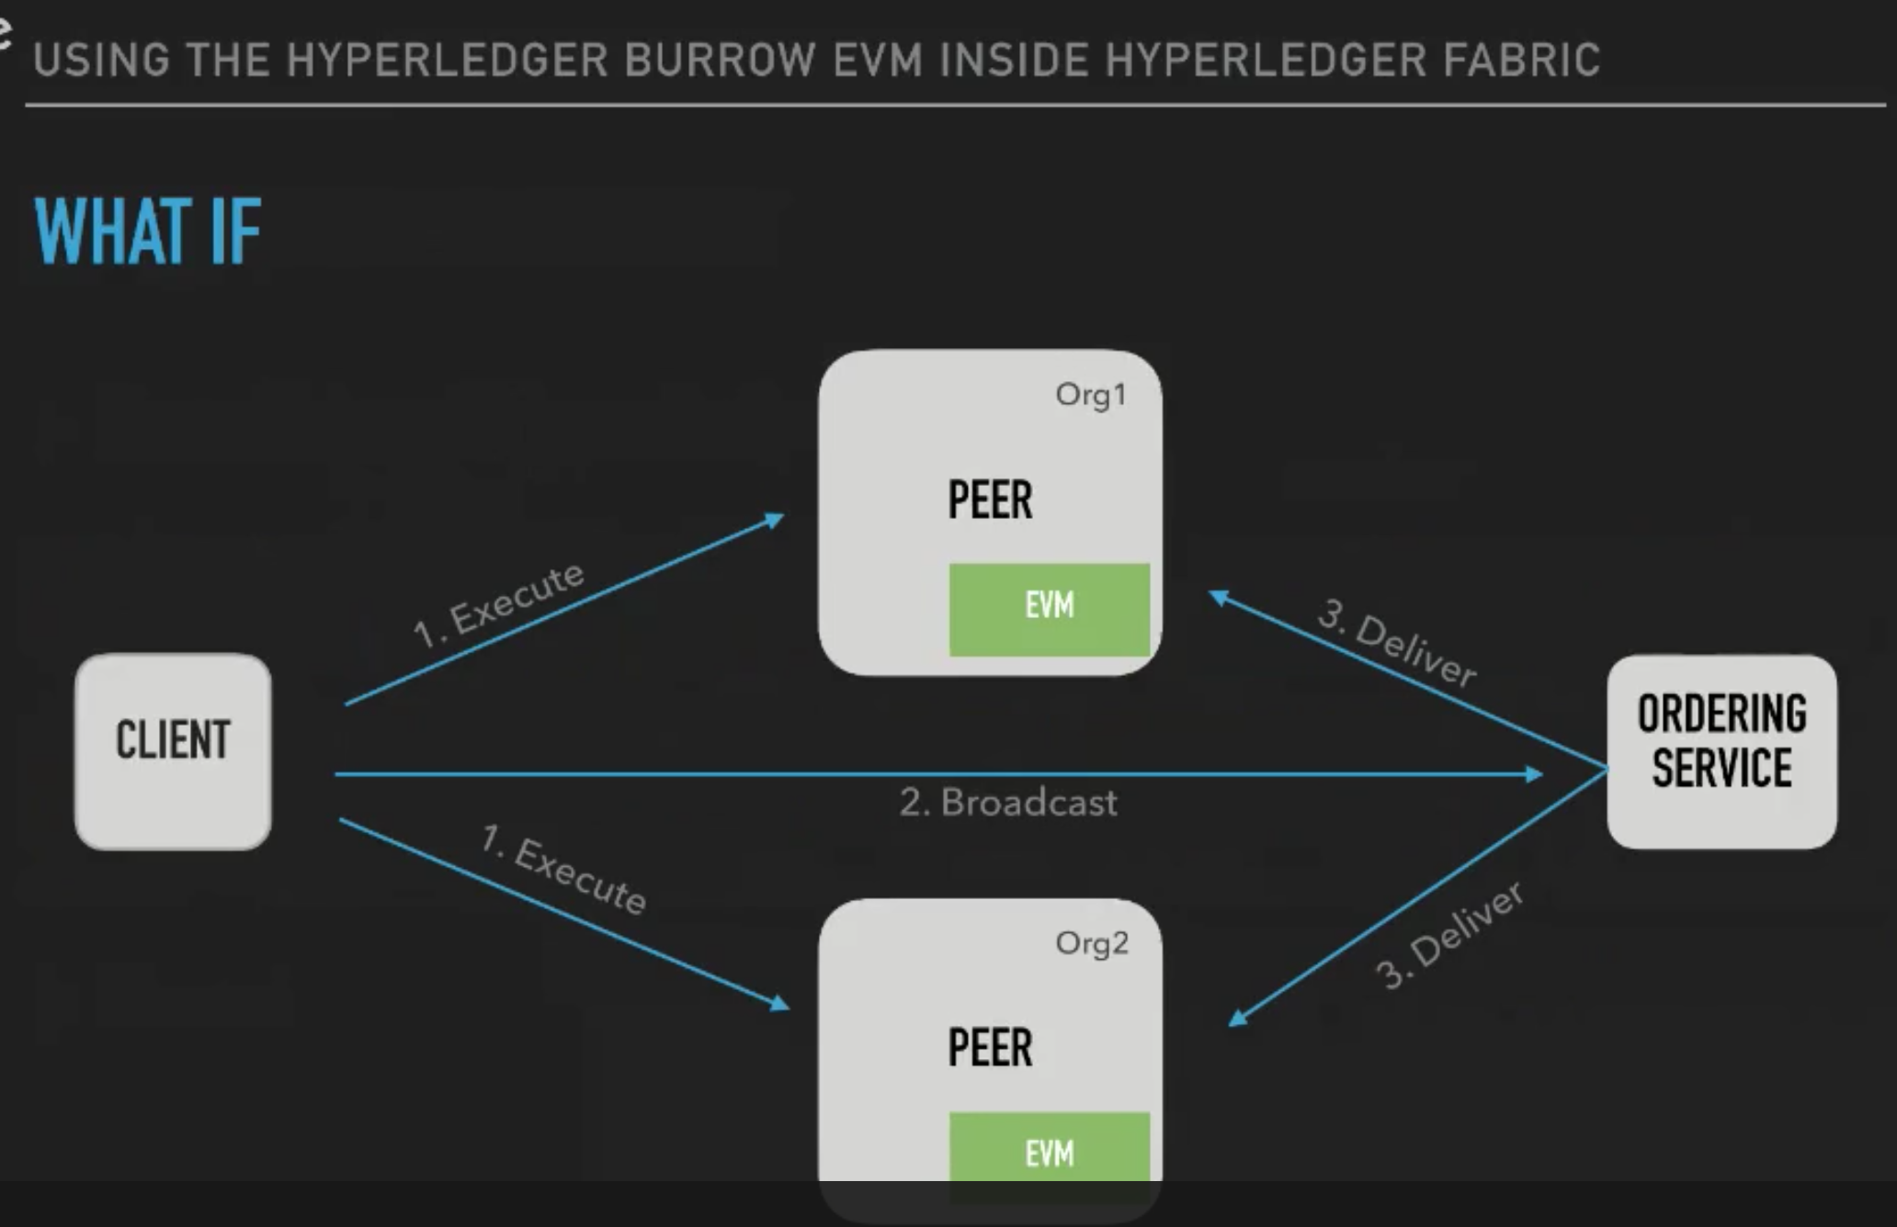
Hyperledger integration
Using the Hyperledger Burrow EVM inside Hyperledger Fabric
Run your Ethereum apps on Hyperledger Fabric
By Swetha Repakula | Last updated October 11, 2018
https://developer.ibm.com/videos/using-the-hyperledger-burrow-evm-inside-hyperledger-fabric/

Slide 19
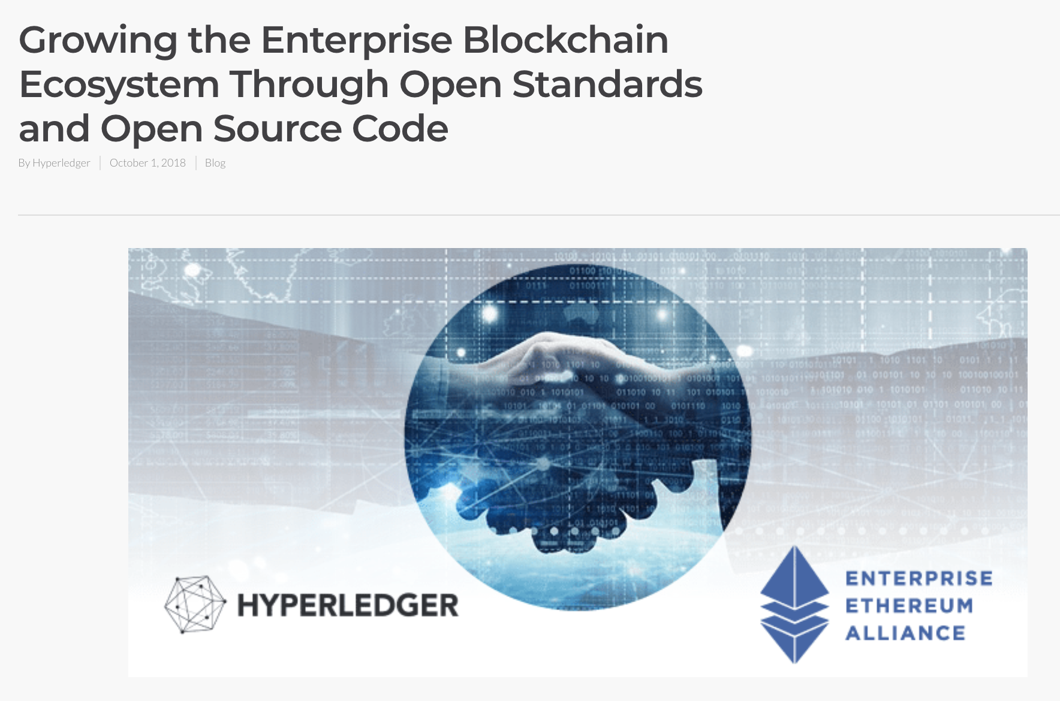

Slide 20
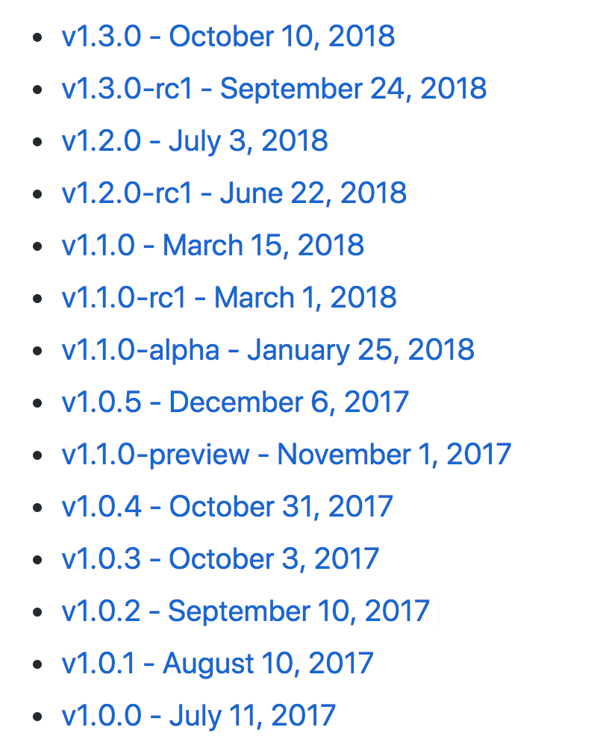
Hyperledger Fabric releases
https://github.com/hyperledger/fabric#releases

Slide 21
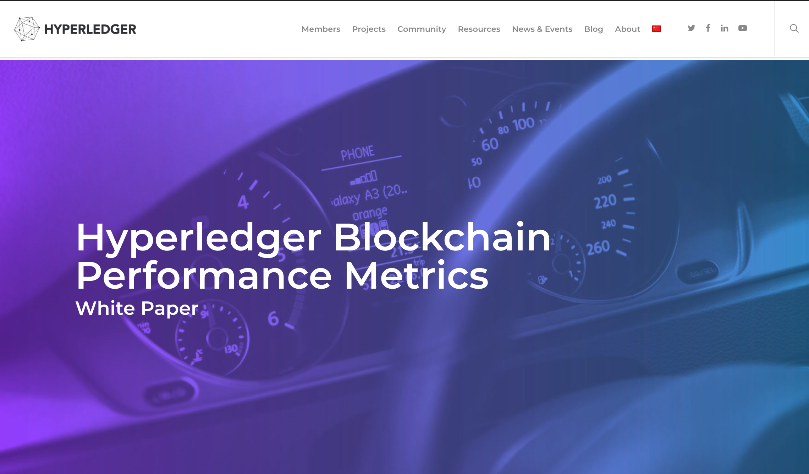
https://www.hyperledger.org/resources/publications/blockchain-performance-metrics

Slide 22
Developing Hyperledger Applications

Slide 23
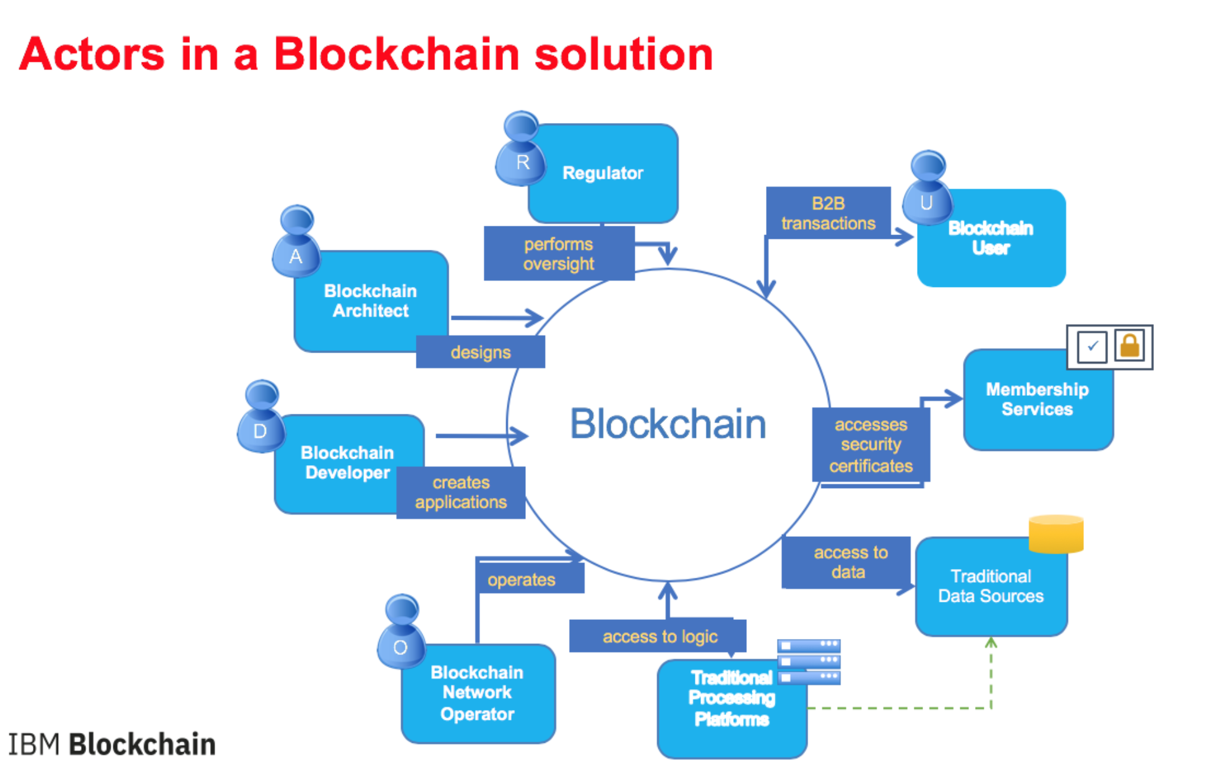

Slide 24
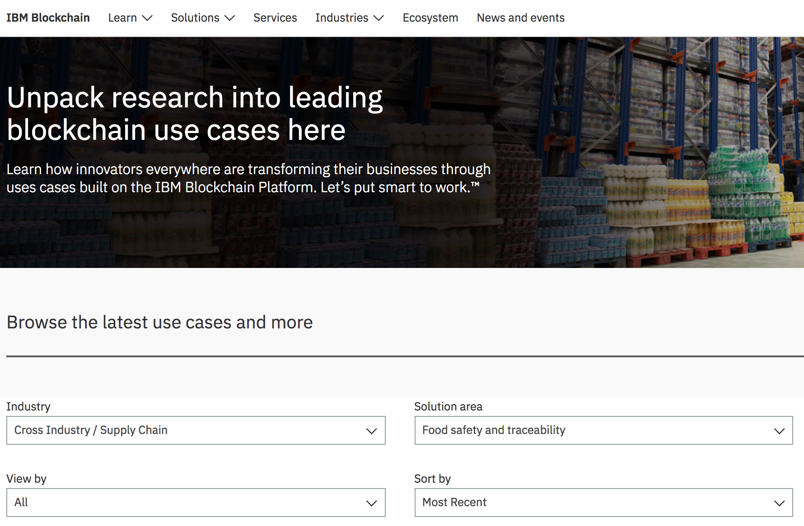
Hyperledger Fabric Use Cases

Slide 25
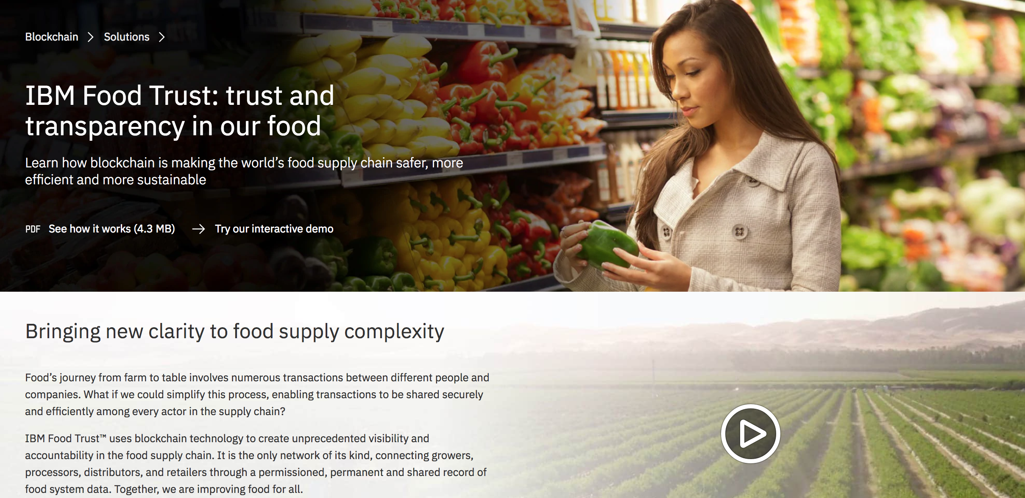
Screen Shot 2018-10-31 at 07.11.06
https://www.ibm.com/blockchain/solutions/food-trust

Slide 26
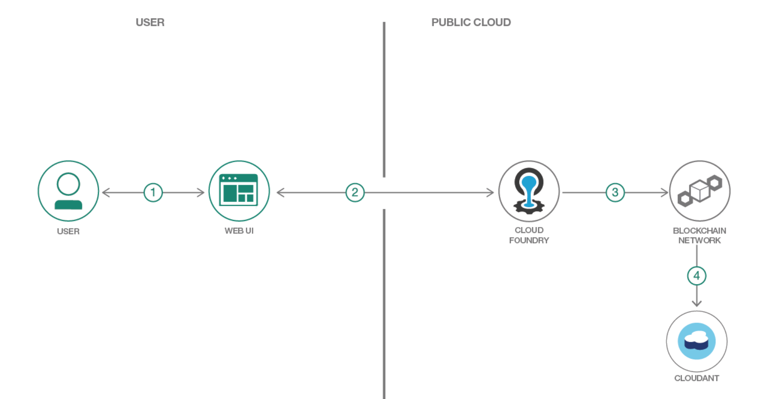
Create a fair trade supply network with Hyperledger Composer and IBM Blockchain Starter Plan
https://github.com/IBM/blockchainbean

Slide 27
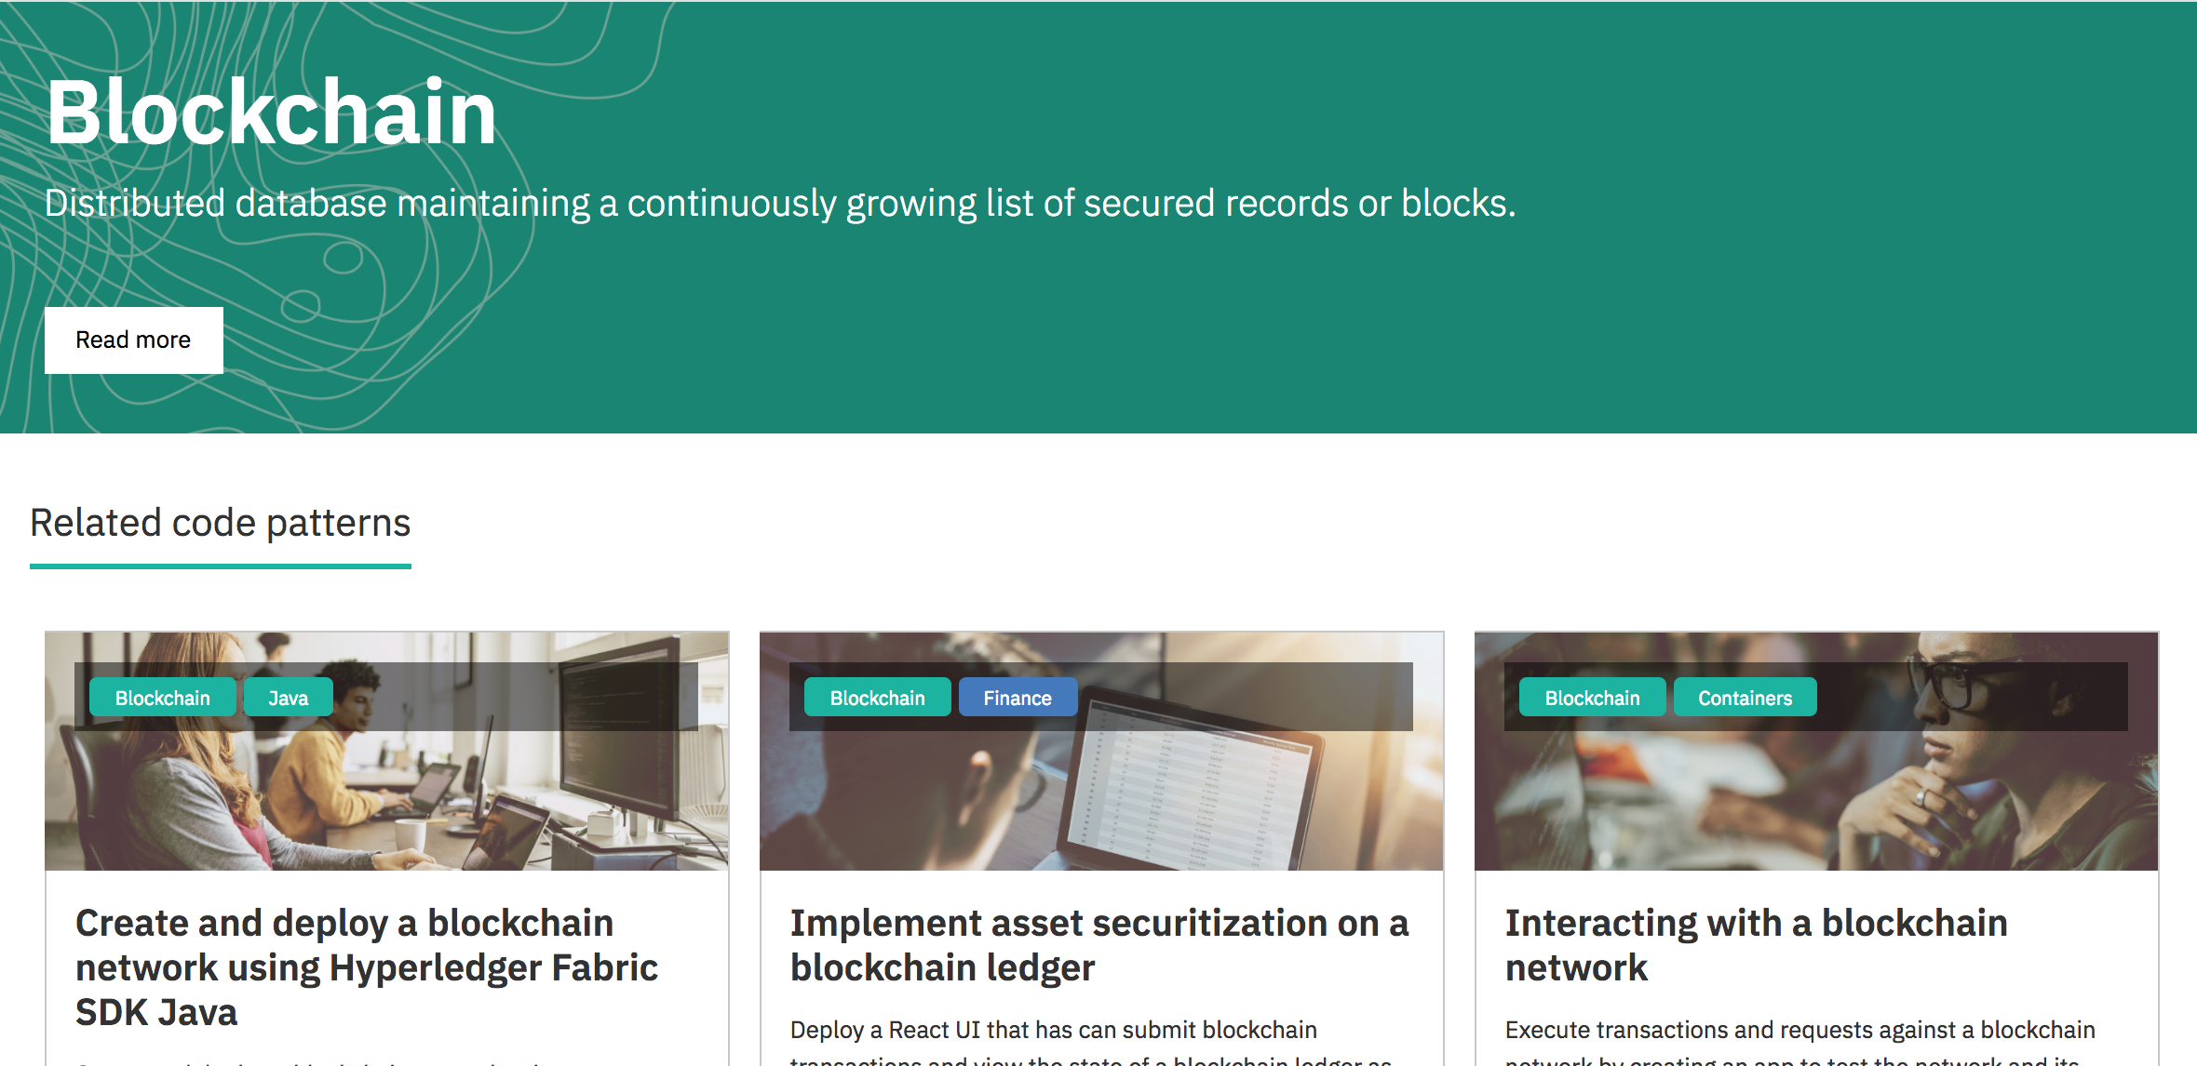
https://developer.ibm.com/code/technologies/blockchain/

Slide 28
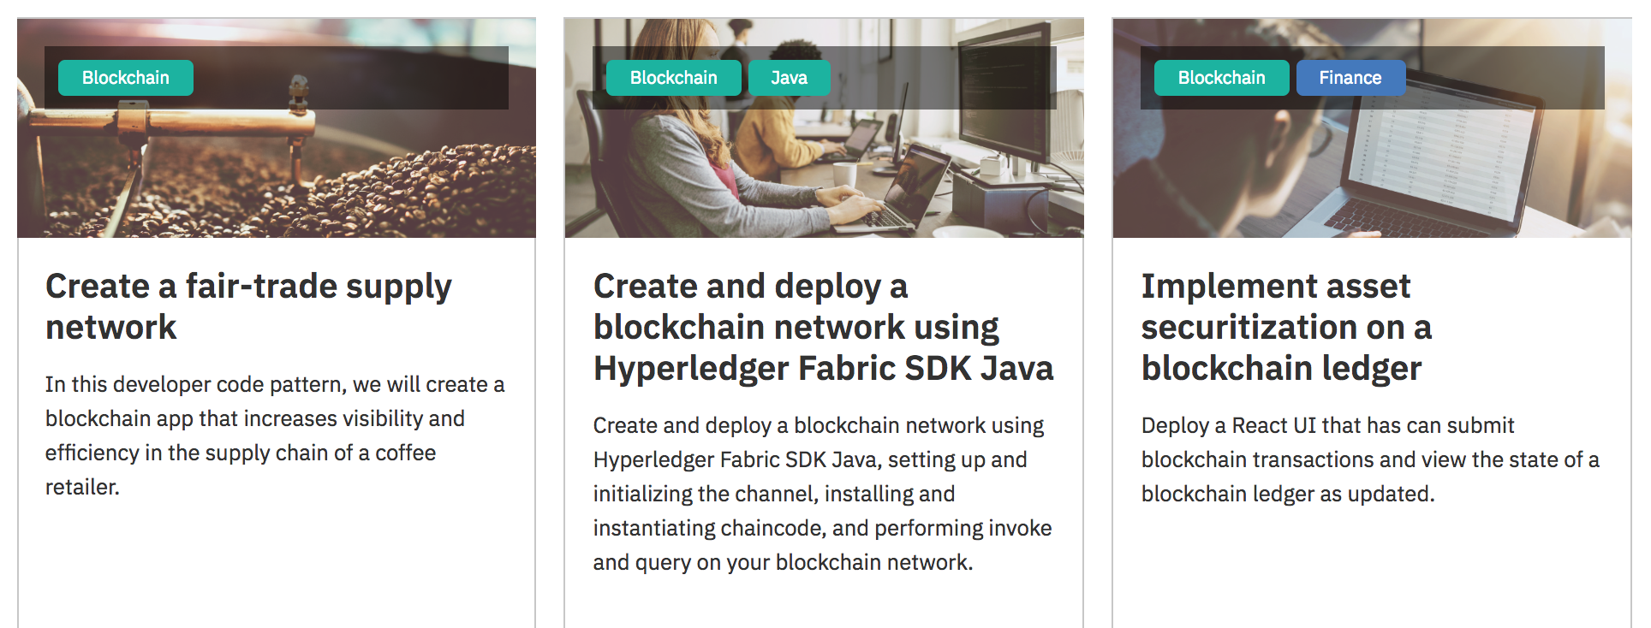
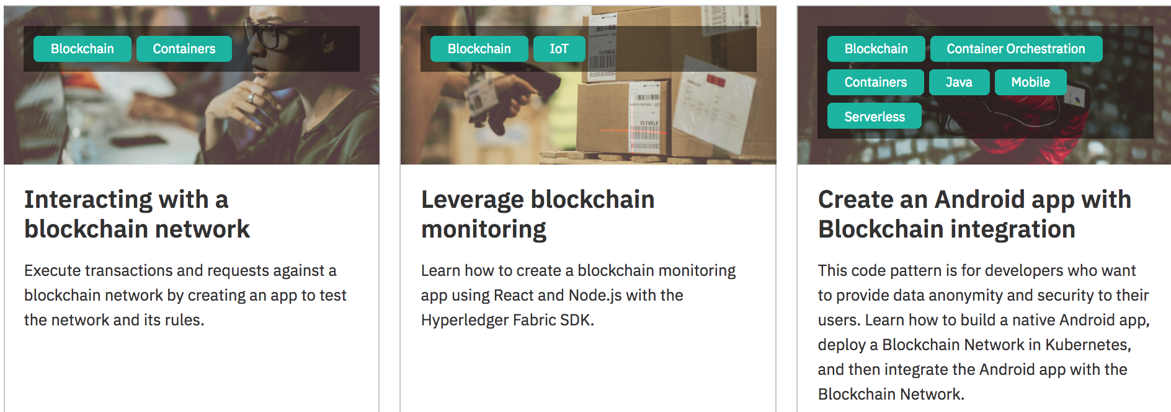

Slide 29
The Cloud

Slide 30
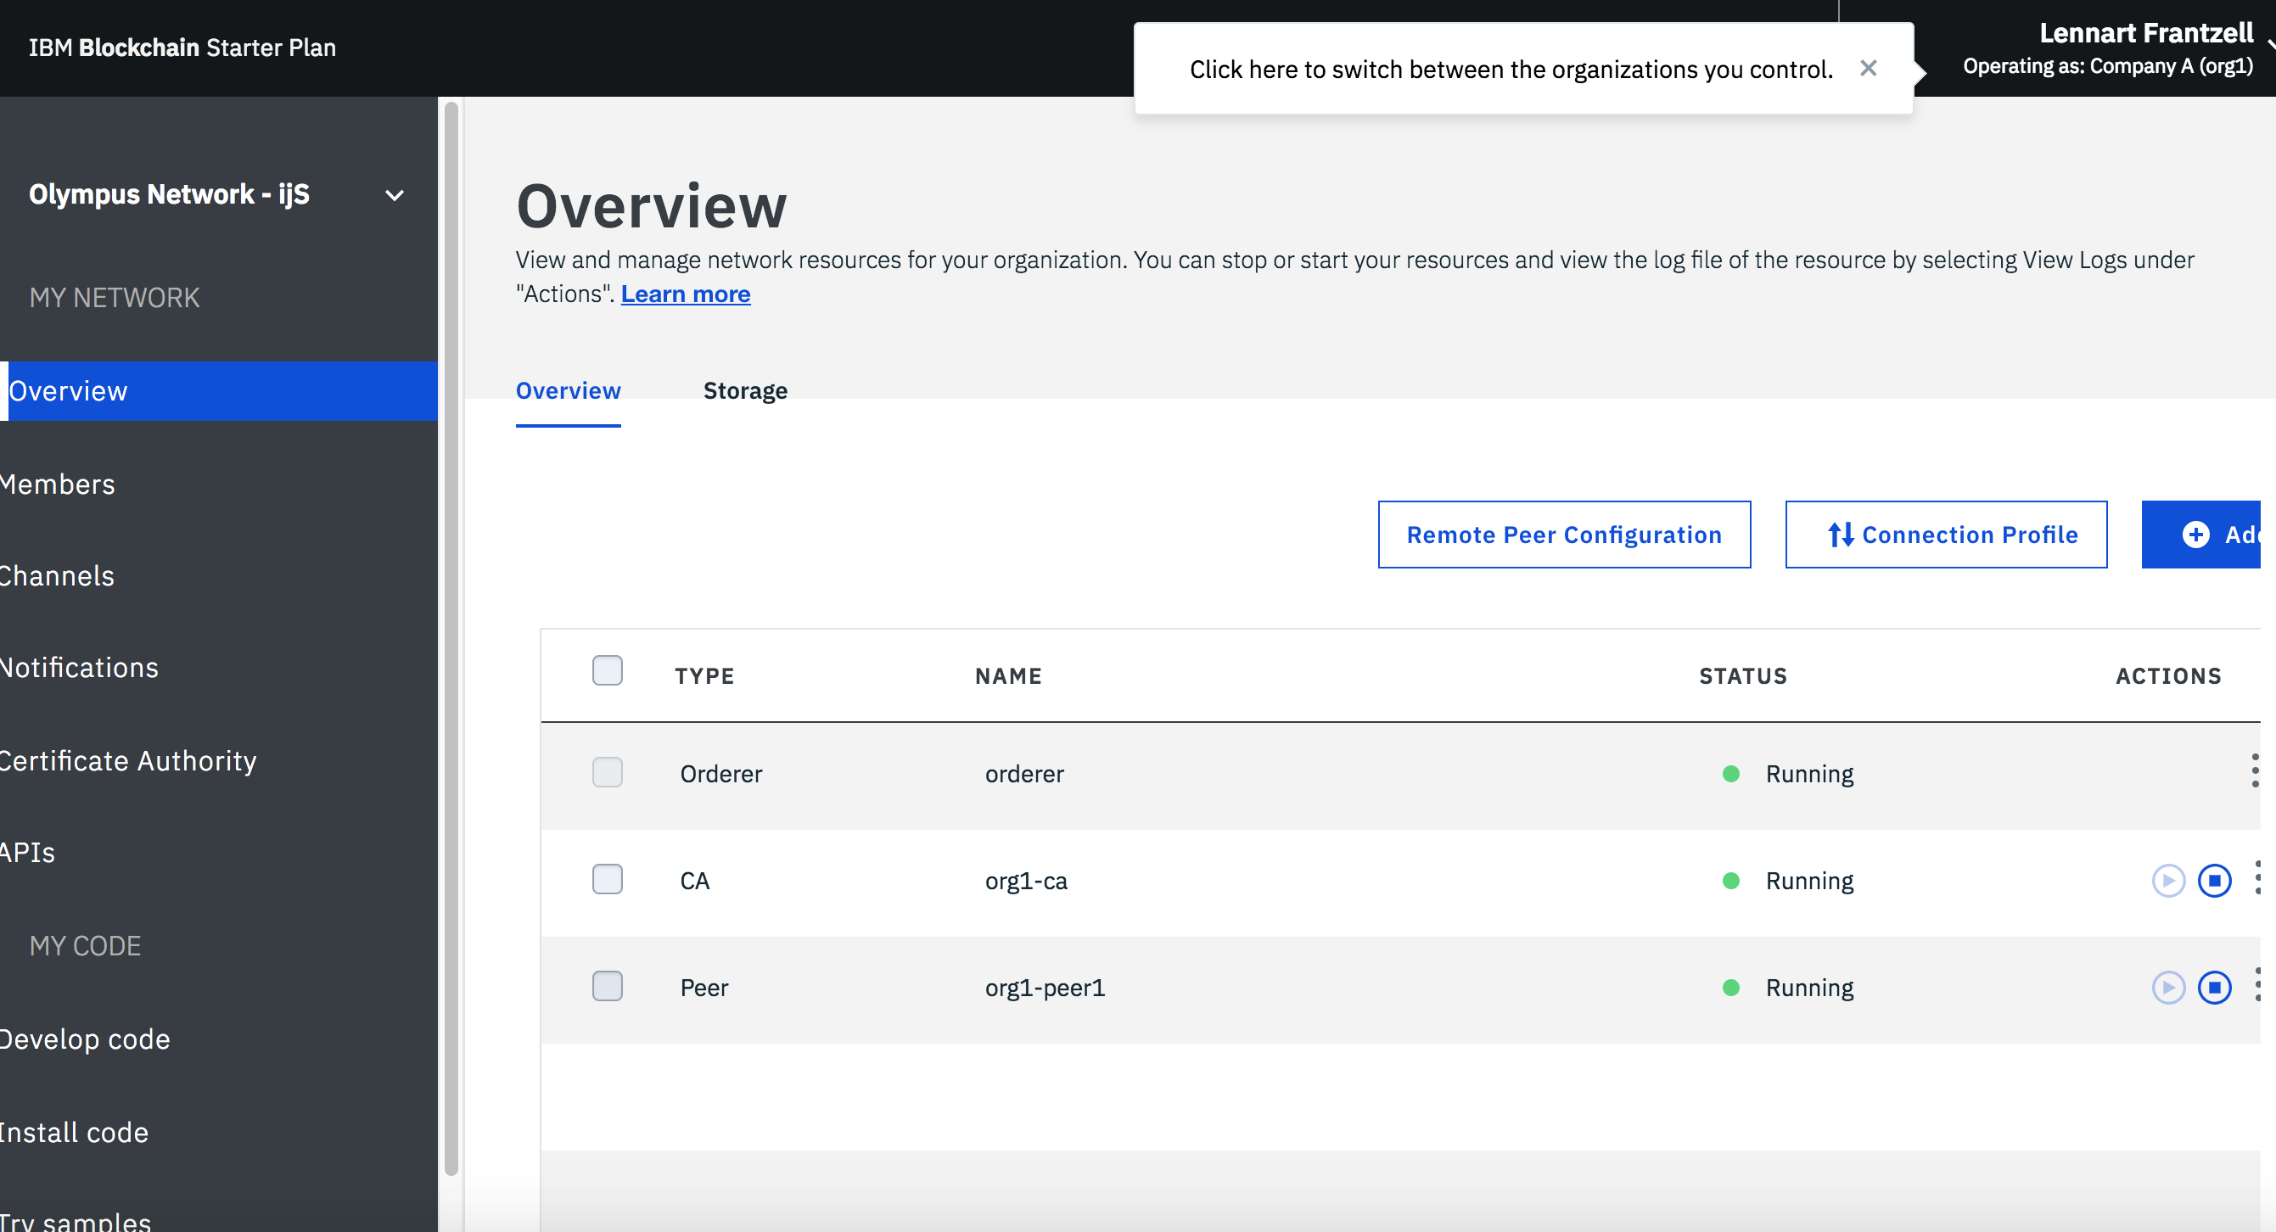

Slide 31








IBM Cloud Garage with Blockchain
Discovery Workshop
Design Thinking Workshop
Dubai
London
Munich
New York
Minimum Viable Product Buildup (MVP)
San Francisco
Singapore
Tokyo
Toronto
Architectural Consultation
… Or we can bring a pop-up location to you!
Notes:
Garage flyer

